Slide 1
YapıKredi
Case Study
By Nurullah Sırça

Slide 2
Income Prediction
Problem Definition:
Salary data is important for many businesses as it can play a significant role in the distribution of their resources. For example, a high-end product needs to market its goods only to people with high incomes.
Since the project determines whether a person makes more than 50K or not, we are determining the dependent categorical variable. Here, we will;
Collect the relevant data set
Prepare the data using pandas, NumPy
Visualize the data to determine the relationship between the variables
Eliminate the outliers and manage missing values
Build our model with ML techniques
Motivation:
Having income data is important in the business world. Because it supports businesses an insight that they need. It gives them a better idea regarding what should be consistent, what went well, what didn't go well, and what would have been done differently in the future.
Having the right set of data, the business will have a clear vision and an informed decision. Income data would help people understand as well as improving the business process which might help people reduce the wasted money or time.
Understanding Data:
age: Represents an individual’s years on earth.
workclass: Represents an individual’s employment status
education_level: Represents an individual’s highest level of education achieved in object form.
education-num: Represents an individual’s highest level of education achieved in numerical form.
marital-status: Represents an individual’s civil status in relation to a significant other.
occupation: Represents an individual’s general occupation
name: Represents name
relationship: Represents an individual’s relation to others in a family unit. The options aren’t consistent and seem to overlap with marital-status column.

Slide 3
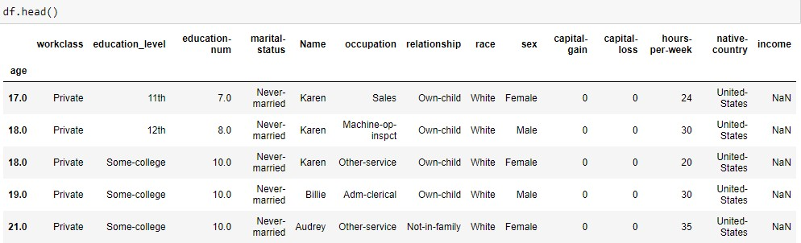
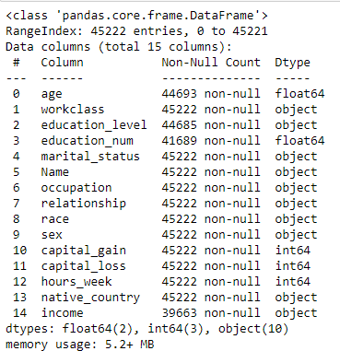
race: Represents an individual’s shared physical or general region of origin
sex: Represents an individual’s gender. This dataset only had two options for gender.
capital-gain: Represents an individual’s profit from the sale of property or an investment
capital-loss: Represents an individual’s loss from the sale of property or an investment
hours-per-week: Represents an individual’s hours worked per week.
native-country: Represents an individual’s country of origin
Income: The amount of money an individual generates within a year.
Data Analysis, Cleaning and Visualization Data Analysis
Firstly, the type of the file was changed to xlsx due to the fact that the CSV file couldn't be read. After then, proper names were given to the column in order to be used in the analysis.
There are 5 numeric and 10 categoric columns

Slide 4
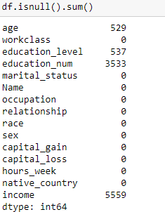
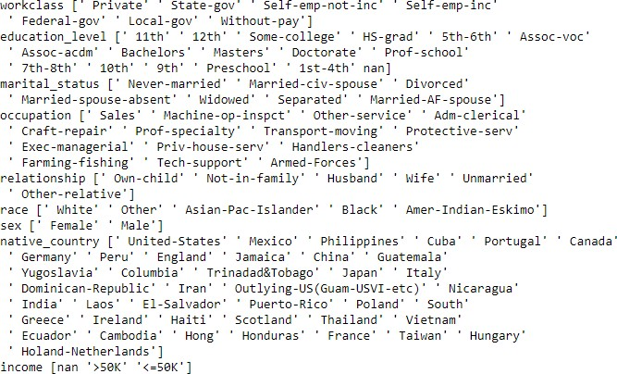
Checking if any cell has missing values
Unique values for each columns

Slide 5
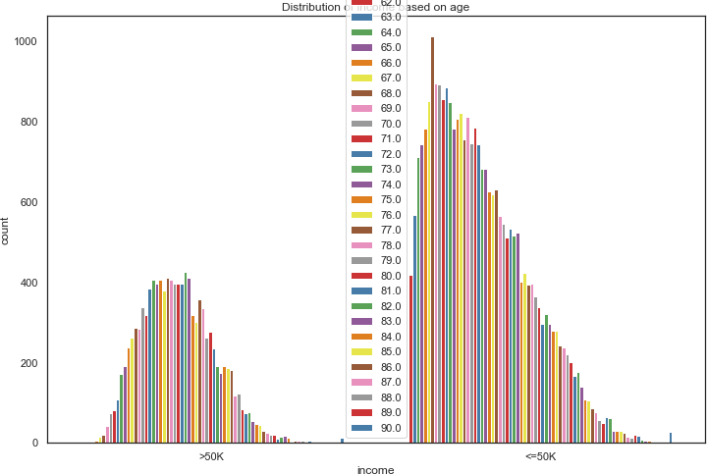
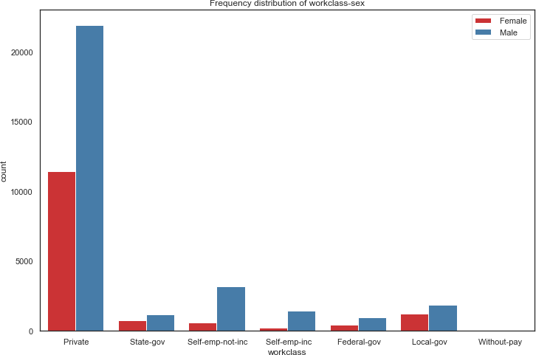
Data Visualization
Age: 1. graph(under 50k) is skewed while 2. graph(more than 50k) is normally distributed.
Workclass: Graph shows that most of the people are engaged in private occupation. In addition, it is seen that there are more male workers than female workers in all the working categories.

Slide 6
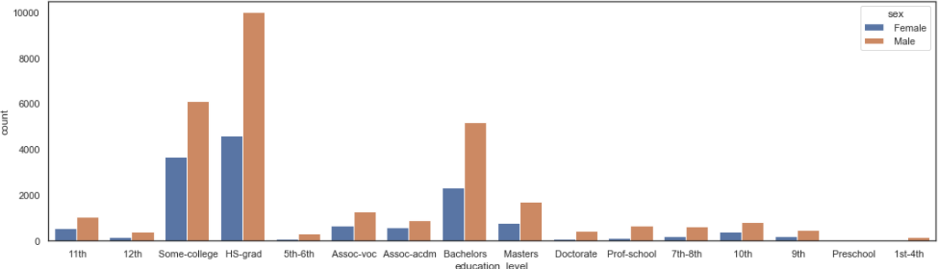
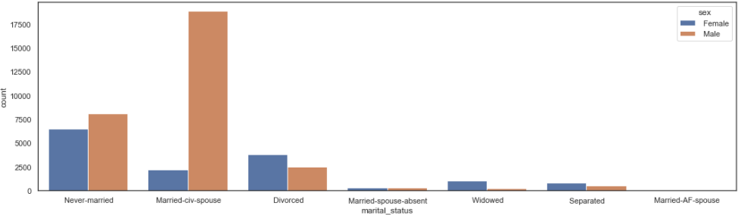
Education Level: The graph is representing the number of people based upon education and sex.
Marital-Status: The graph is representing the number of people based upon marital-status and sex.

Slide 7
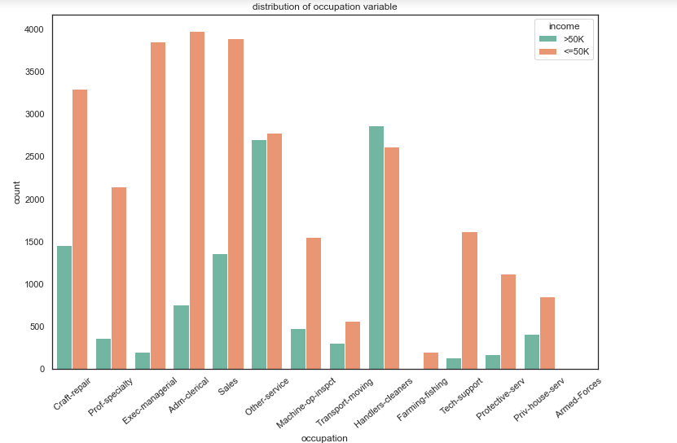
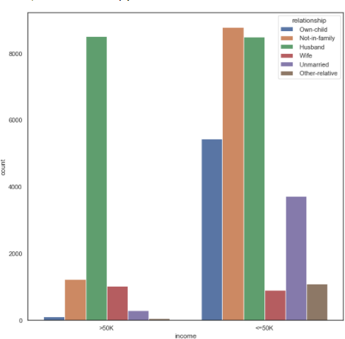
Occupation: The graph is representing the number of people based upon job types and income.
Relationship: The graph is representing the number of people based upon relationship and income.

Slide 8
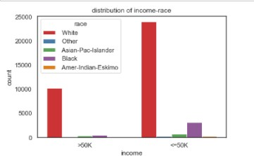
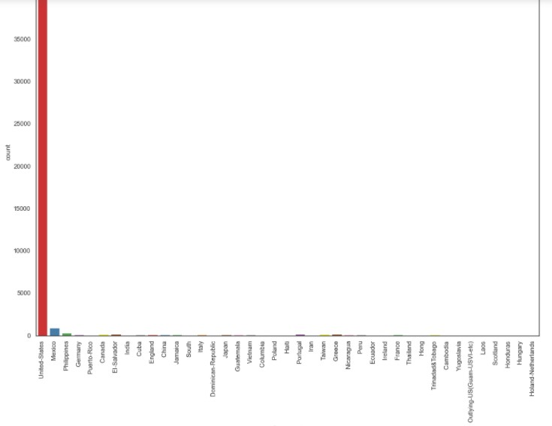
Race: Most of the people are white and followed by Black.
Native country: People are mostly from the USA as it is seen on the graph.

Slide 9
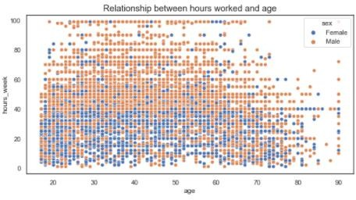
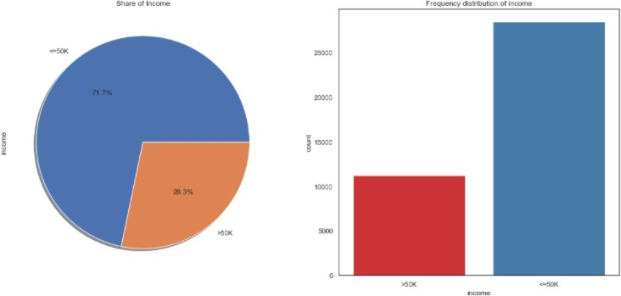
Hours per week: There is no definite relationship between age and hours they work. However, it is seen that male tends to work more hours per week.
Income : The majority of people have an income of less than 50k. The graph shows that males make more money than females in both the income categories.

Slide 10
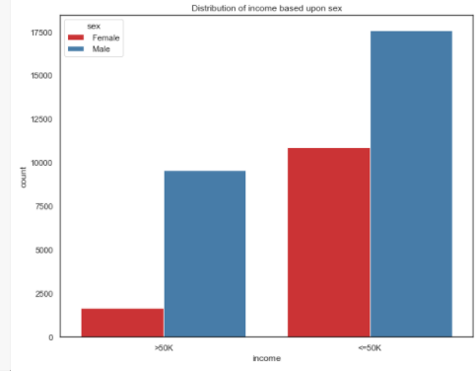
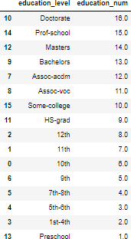
Feature Engineering and Data Cleaning
1. Relationship between educaton_level and education_num. Because I thought that there can be similarities between them.

Slide 11
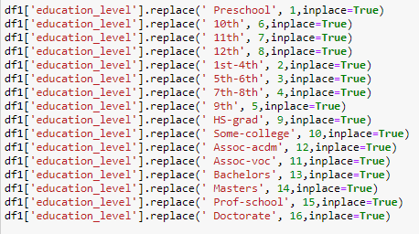
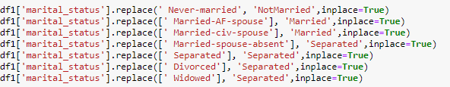
After checking the relationship between education_level and educationn_num, we recognized that education_num was labeled based on educational_level. On the other hand, missing values in education_level and education_num are not on the same row. Namely, education_level has no NaN values in the rows where education_num has NaN values, and education_num has no NaN values in the rows where education_level has NaN values. The best way to deal with missing values is to do imputation of education_level with the values of education num. It is impossible to do an imputation for the missing values of education_num as it has 3533 missing values.
As it is seen above, values of education_level were replaced by education_num’s values and missing values of education_level were filled with the values of education_num. After then, a column of educaton_num was dropped in order to avoid duplication. The reason for missing values can be caused by human mistakes.Column of name was dropped as it has no any logical correlation among other columns.
2. Marital status.
For reasons of simplicity and similarities, attributes were simplified. Married-AF-spouse and Married-cv-spouse were combined as Married. Married-spouse-absent, Separated, Divorced and Widowed were combined with Separated, and Never-married was added to NotMarried.Native-countries

Slide 12
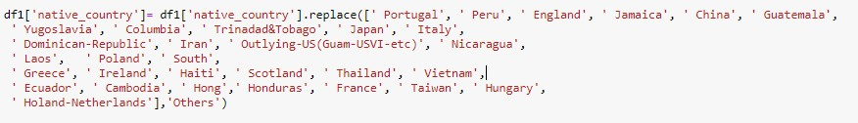
As it is analyzed in the visualization part, the graph shows that most of the people in the dataset are from America and followed by some of the other countries. Few people are from other countries. Other countries where have few people in the USA were grouped as
‘others’.
Income
As it is a classification problem, one of the best ways is to map the income labels numerically, as <=50K is ‘0’ and >50K is ‘1’.
Age
As it is seen on the graph of income-age in visualization part, the age of people who have less than 50K has skewed distribution and therefore missing values of that columns were filled with a median of age. On the other hand, the age of people who have more than 50K has a normal distribution and therefore missing values of that columns were filled with the mean of age.
Lastly other rows having null values were dropped in the Income column(There were null values only for the Income column. No need to do imputation of income columns with mean or median values. It can lead to wrong results.
Correlation Matrix of Numerical values

Slide 13
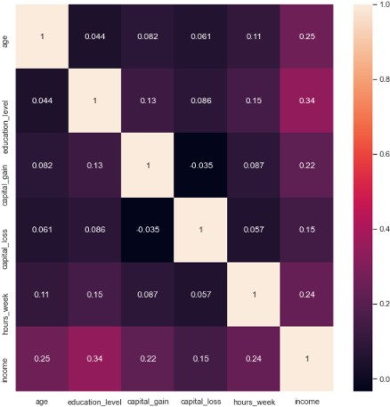
The Correlation Matrix shows that there is no certain correlation among features.
Building Machine Learning Models
Several types of ML models were used with Scaling, non-scaling, oversampling with scaling. The best result was gained from oversampling ones even though Scaling ones gave good results. In this report, I will explain the result of ML models with oversampling . You can check oğther models with Scaling and non-scaling in the notebook.
Feauture Encoding
Categorical variables were encoded with One-Hot Encoding.

Slide 14
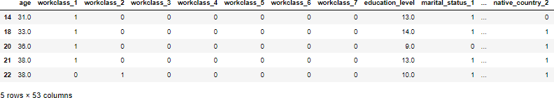
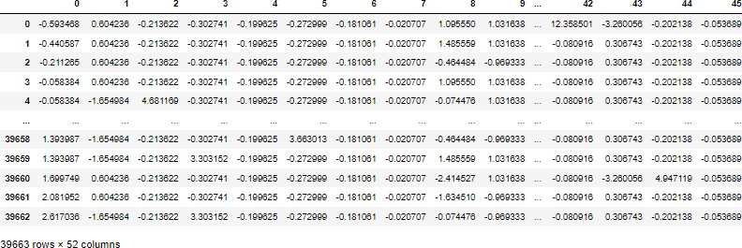
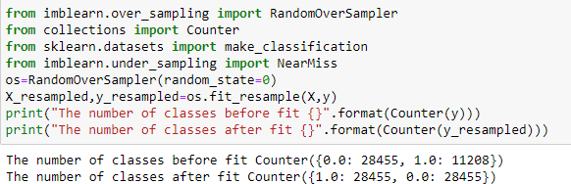
Scaling (StandardScaling)
After the income column was dropped, all the numerical values have been scaled to a range between -1 to 1.
Train-test Split
Oversampling Method
Income dataset is imbalanced.
As it is seen above, data is imbalanced with 7:3. Hence, data was resampled with the oversampling method. Undersampling was not used in the case, because it didn’t give good results in terms of accuracy.

Slide 15
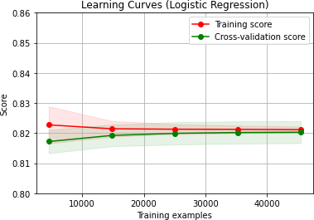
Learning Curve
This learning curve clearly shows that our models are not learning anything after ~56,000 samples. So dataset was randomly sampled and used only 56,000 samples of our dataset.
Note: In the plot, only ~40 000 samples are shown because it is a plot for training set.
Evaluation Approach
For the Income dataset, False Negative Rate is one of the best metrics to evaluate the model. The lower the number of false negatives, the better the model is. In this project, False negative is when the model predicts ‘ income holder will have <=50k even though he has over 50K.’ Our model cannot afford to have higher false negatives as it leads to a negative impact on the investors. Hence, our models were evaluated using the number of False Negatives and accuracies.
NOTE: The bottom left cell represents False Negative Rate.

Slide 16
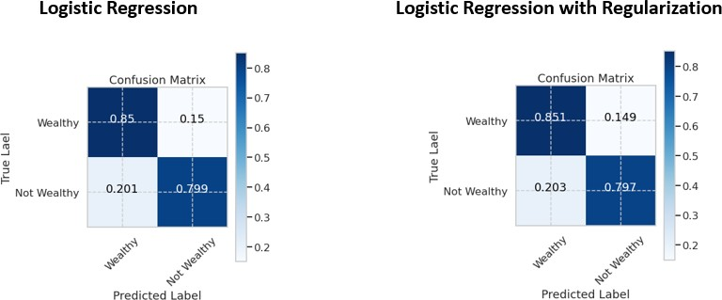
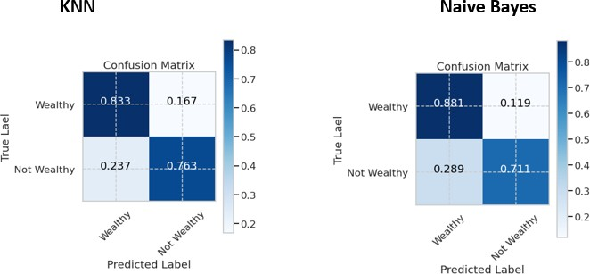
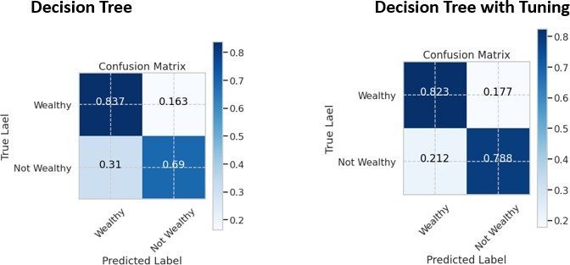

Slide 17
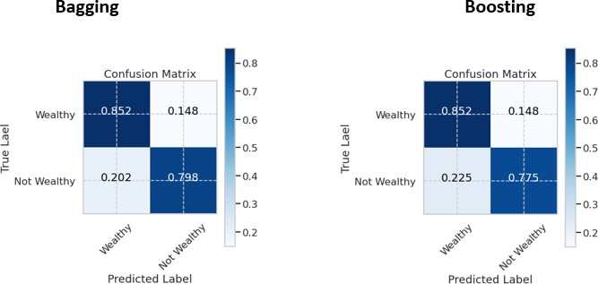
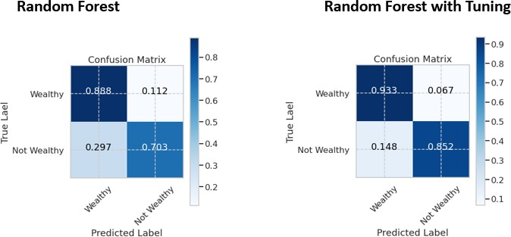
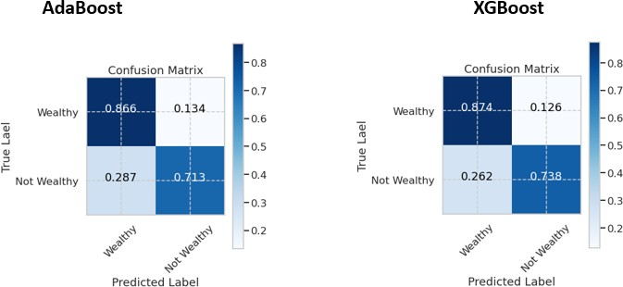

Slide 18
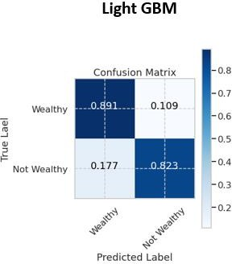
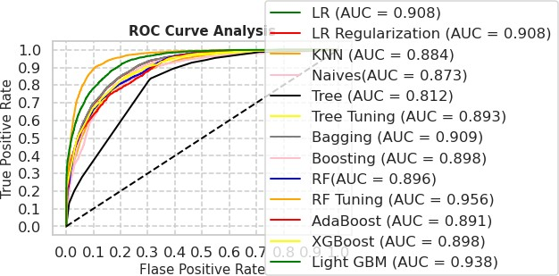
Receiver Operating Characteristic Curve

Slide 19
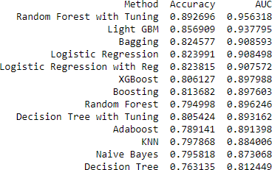
From the confusion matrices and ROC Curve Analysis, we can infer that Random Forest with Hyperparameter Tuning had the least False Negative Rate with the highest AUC. Consequently, Random Forest with Hyperparameter Tuning is the most accurate model.
Scope of Problem
Our problem can be expressed as a Supervised learning problem where we have a target variable specified. We have used supervised learning algorithms like Random Forest, Logistic Regression, Naive Bayes, Ensemble Techniques, and more.
We had around 45000 observations of data. By implementing a learning curve for the data, it was realized that the models do not learn after approximately 40000 observations of the training set.
The data has been preprocessed using techniques like scaling, filling null values, and more.
Conclusion
In summary, what has been achieved so far;
A classification model based on the random forest(with tuning) algorithm has been developed to help determine the creditworthiness of individuals. It is important to note that this is only assistance in this case. Because of that, the data basis allows only a determination as to whether a person earns more or less than 50k, more complex calculations around the granting of credit cannot be applied. Therefore, the model could be used in the first step of lending. If a potential lender asks his bank for a loan, the service personnel can determine with the help of personal data that is easy to determine whether the person has possible creditworthiness and whether it is profitable for the credit institution to process the loan application further. In this case, the service staff could refer the customer to an expert.

Slide 20
Note: The case was concluded from the perspective of a bank or a financial instituation.

